Slide 1

Lessons Learned From Agile Quality Assurance In Scrum

Slide 2
Agenda
Product quality
Code quality
Practices in building cloud-based system
Cautions

Slide 3
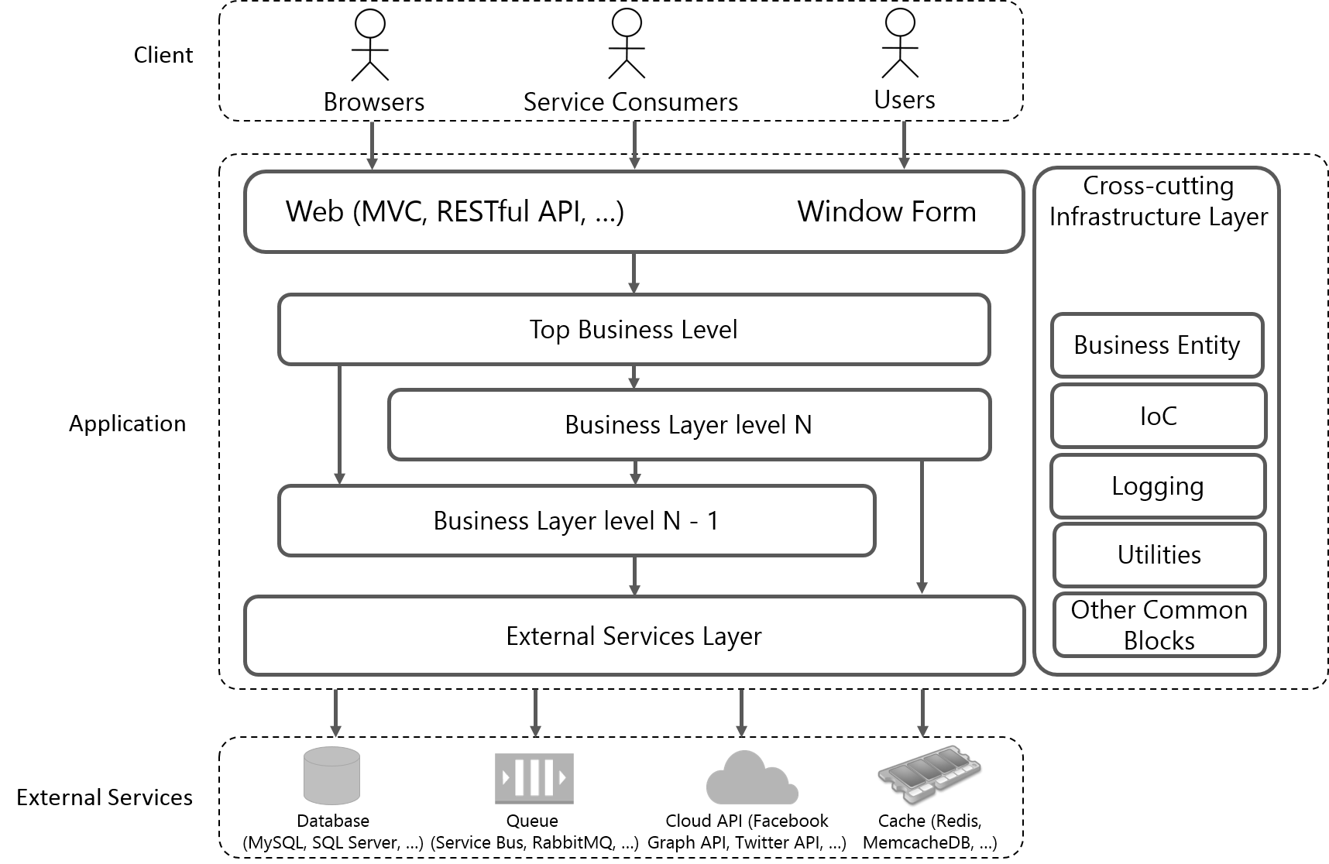
Product Quality The conceptual structure of an application to software testing

Slide 4
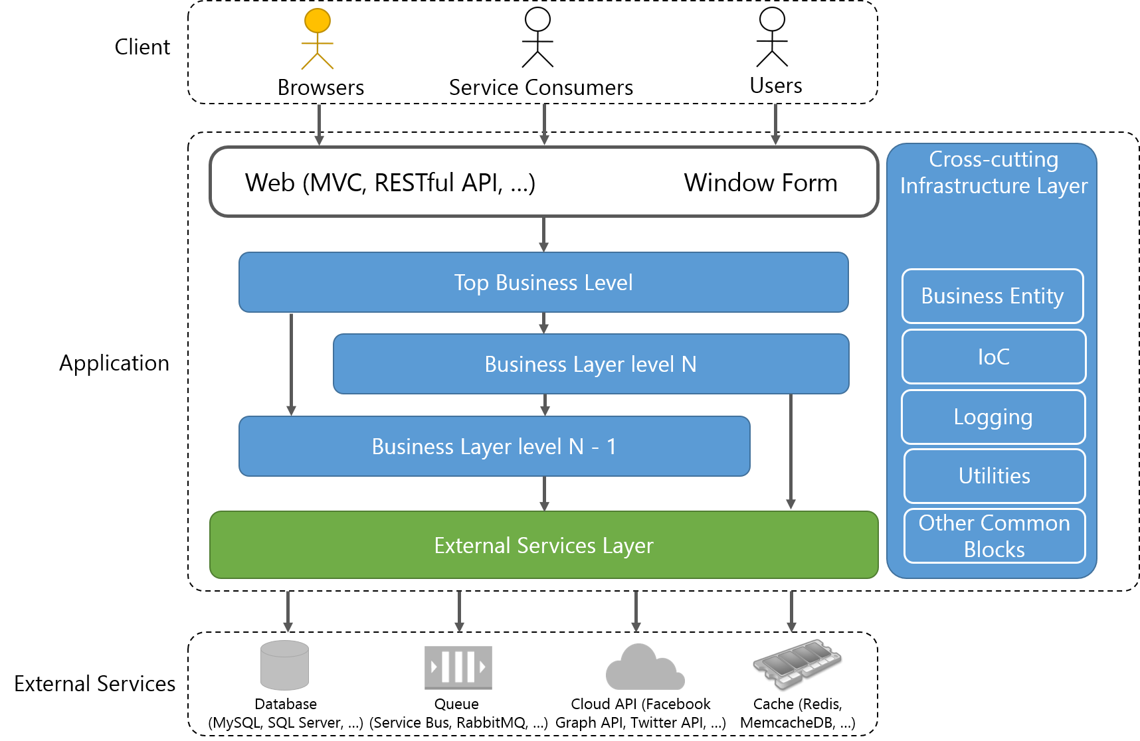
Product Quality  Software components and their testing
Covered by “GUI Unit” Testing
Covered by Unit Testing
Covered by Integration Testing

Slide 5
Product Quality  Software components and their testing

Slide 6

Product Quality  Perform “System Testing” to test the entire application
System Testing
Automated System Testing
Manual System Testing
End-To-End Testing
“Behind-The-Scenes” Testing
Simulate real user scenarios to test the entire application.
Call the top business level to test the application.

Slide 7
Product Quality  Demonstrate how we performed those types of testing
GUI Unit Testing
Integration Testing
Unit Testing

Slide 8
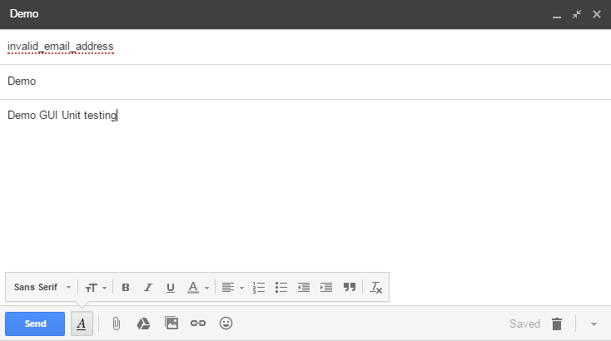
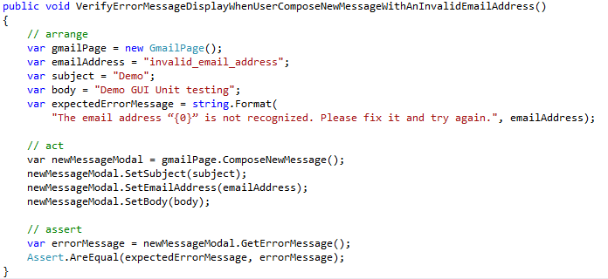
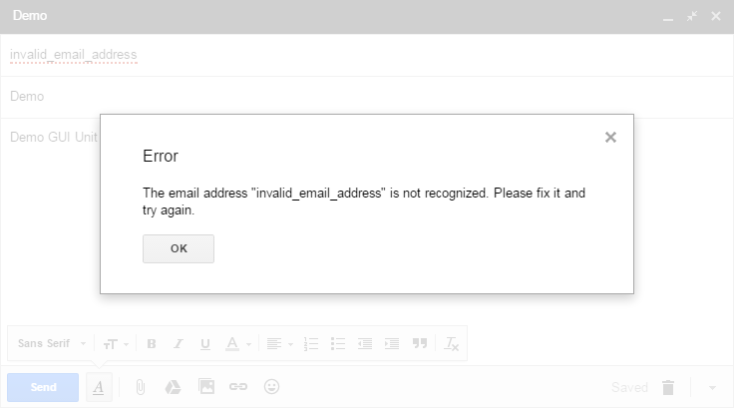
Product Quality  Demonstrate how we performed those types of testing
GUI Unit Testing
1
2
Given: User have already logged in to Gmail and compose new message with an invalid to email address like this ‘invalid_email_address’.
When: User click Send button.
Then: A pop-up appear to notify that <The email address “invalid_email_address” is not recognized. Please fix it and try again.>

Slide 9
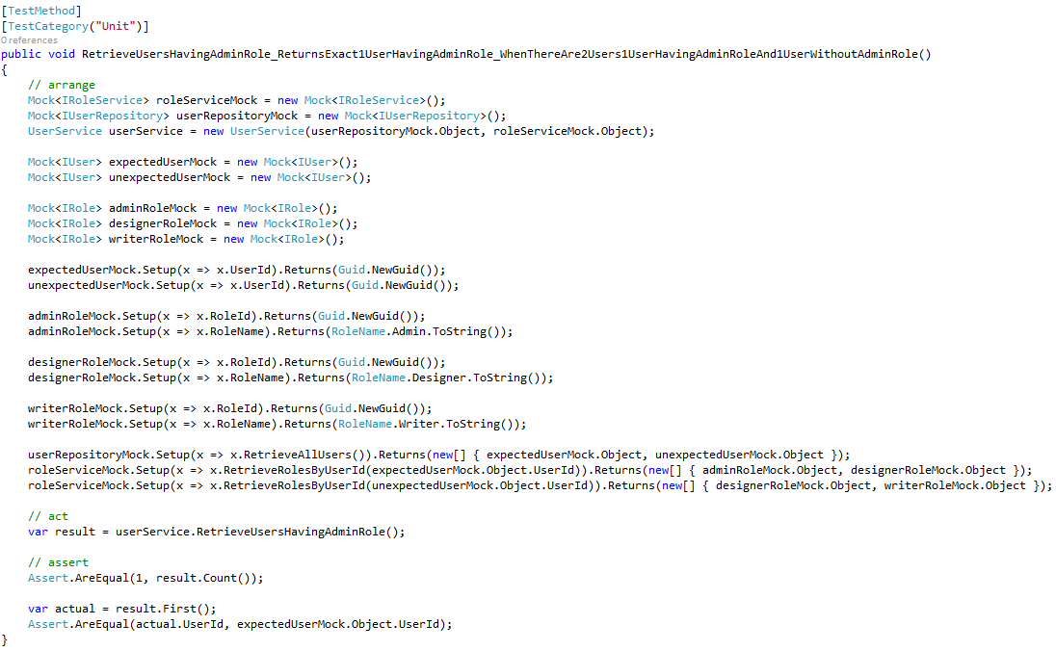
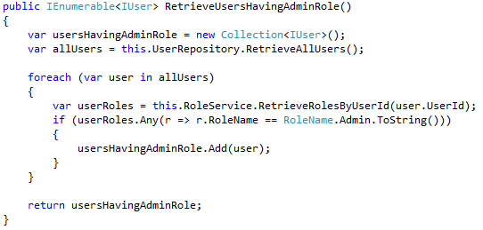
Product Quality  Demonstrate how we performed those types of testing
Unit Testing

Slide 10
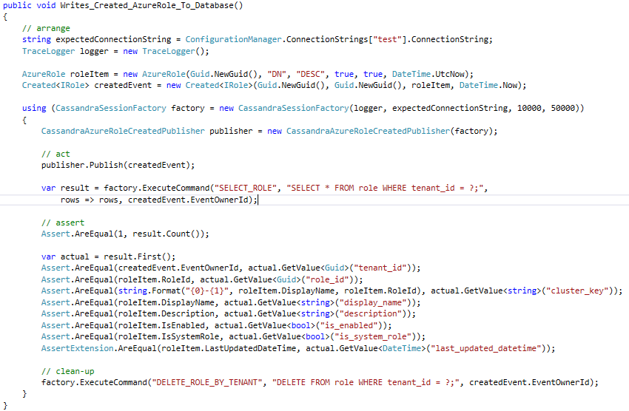
Product Quality  Demonstrate how we performed those types of testing
Integration Testing

Slide 11
Code Quality  Code review process
When
Who
How
Benifits
Immediately new code is produced.
Peer developers
Assert coding conventions
Assert algorithms
Assert OOP design
Assert project conventions (file location, project name, configuration, etc.)
Code analysis tools
Detect hidden faults / bugs very soon.
Refactor code frequently.
Ensure coding conventions.
Prevent code from getting mess.

Slide 12
Practices in building cloud-based system
Firewall (company policy)
Slow  timeout errors
Ineffective license purchase
Time-zone
Not isolated resources (Queue, Cloud Account)

Slide 13
Cautions
Code review
Take time, blocking
Require designing for new feature available before doing (1 - 2 days to breakdown tasks)
Tests
Take too much time  1 code ~ 3 types of testing
Require QA-mindset from Dev
Maintenance
Add/remove properties, change constructors  update all related tests

Slide 14
References

Slide 15
Thank you for listening

Slide 16
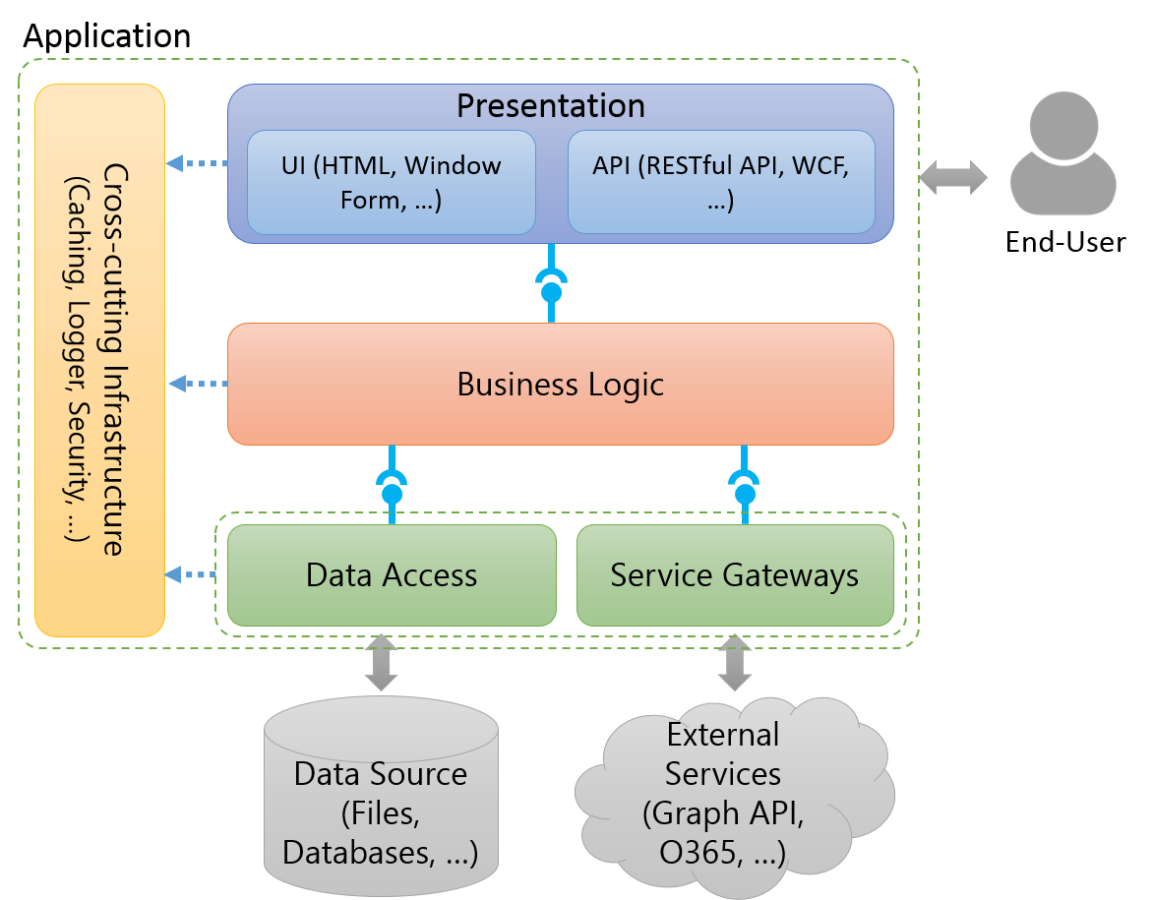
The conceptual structure of an application to software testing
Notes:
To talk something about the conceptual structure of an application to show to audiences the structure which is applied in almost applications.

Slide 17
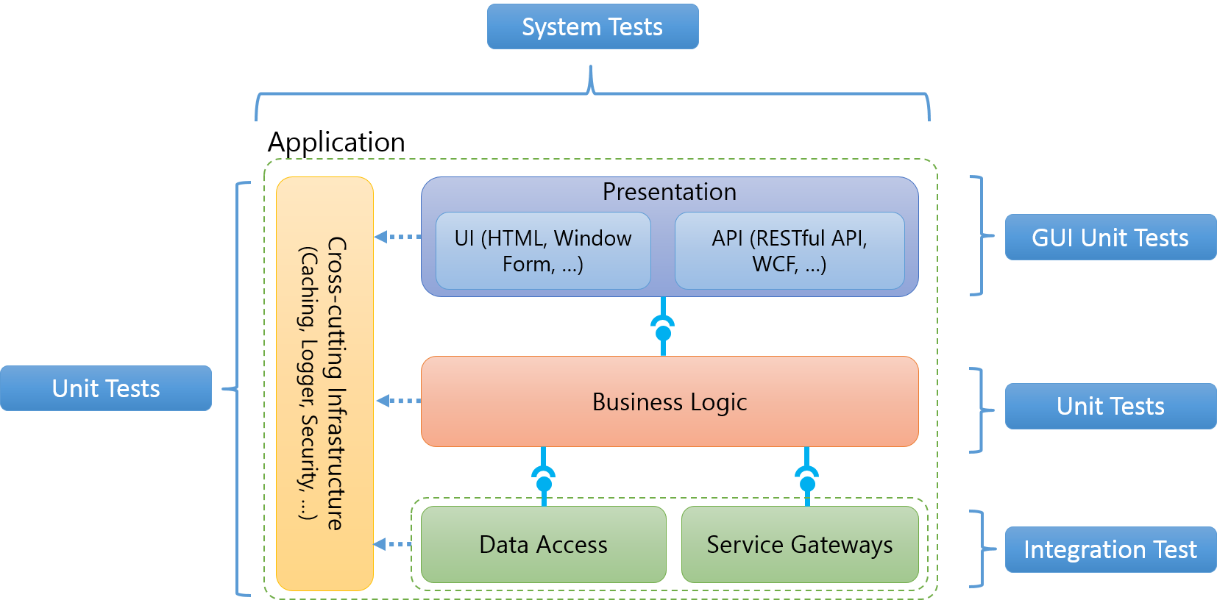
The conceptual structure of an application to software testing
Notes:
To indicate what aspects of an application are covered which types of test (Ex: Business Logic is covered by unit tests.)

Slide 18

Application
Cross-cutting Infrastructure
(Caching, Logger, Security, …)
Presentation
UI (HTML, Window Form, …)
API (RESTful API, WCF, …)
End-User
Business Logic
Data Access
Service Gateways
Data Source (Files, Databases, …)
External Services (Graph API, O365, …)

Slide 19
System Tests
Application
Cross-cutting Infrastructure
(Caching, Logger, Security, …)
Presentation
UI (HTML, Window Form, …)
API (RESTful API, WCF, …)
GUI Unit Tests
Unit Tests
Business Logic
Unit Tests
Data Access
Service Gateways
Integration Test
Notes:
http://blogs.msdn.com/b/jmeier/archive/2008/11/24/application-architecture-diagrams-added-to-codeplex.aspx

Slide 20




Client
Browser
Web Server
Business Entity
Presentation
Cross-cutting Infrastructure
UI (MVC, Window Form, …)
API (RESTful API, WCF, …)
Configuration
Business Logic
Logging
Utilities
Service Gateways
Other Common Blocks
Database
(Cassandra, MongoDb, …)
Queue
(Service Bus, RabbitMQ, …)
Cloud API (Facebook Graph API, Twitter API, …)
Memcache (Redis, MemcacheDB, …)
Notes:
http://blogs.msdn.com/b/jmeier/archive/2008/11/24/application-architecture-diagrams-added-to-codeplex.aspx

Slide 21


Client
Browsers
Service Consumers
Users
Web (MVC, RESTful API, …)
Window Form
Cross-cutting Infrastructure Layers
Top Business Level
Business Entity
Application
Business Layer level N
IoC
Logging
Business Layer level N - 1
Utilities
External Services Layer
Other Common Blocks
External Services
Database
(MySQL, SQL Server, …)
Queue
(Service Bus, RabbitMQ, …)
Cloud API (Facebook Graph API, Twitter API, …)
Cache (Redis, MemcacheDB, …)

Slide 22
Client
Browsers
Service Consumers
Users
Web (MVC, RESTful API, …)
Window Form
Cross-cutting Infrastructure Layers
Top Business Level
Business Entity
Application
Business Layer level N
IoC
Logging
Business Layer level N - 1
Utilities
External Services Layer
Other Common Blocks
External Services
Database
(MySQL, SQL Server, …)
Queue
(Service Bus, RabbitMQ, …)
Cloud API (Facebook Graph API, Twitter API, …)
Cache (Redis, MemcacheDB, …)

Slide 23
Covered by Unit Testing
Covered by GUI Unit Testing
Covered by Integration Testing

Slide 24

Client
Browsers
Service Consumers
Users
Web (MVC, RESTful API, …) Window Form
Cross-cutting Infrastructure Layer
Top Business Level
Business Entity
Application
Business Layer level N
IoC
Logging
Business Layer level N - 1
Utilities
External Services Layer
Other Common Blocks
External Services
Database
(MySQL, SQL Server, …)
Queue
(Service Bus, RabbitMQ, …)
Cloud API (Facebook Graph API, Twitter API, …)
Cache (Redis, MemcacheDB, …)

Slide 25

Client
Browsers
Service Consumers
Users
Web (MVC, RESTful API, …) Window Form
Cross-cutting Infrastructure Layer
Top Business Level
Business Entity
Application
Business Layer level N
IoC
Logging
Business Layer level N - 1
Utilities
External Services Layer
Other Common Blocks
External Services
Database
(MySQL, SQL Server, …)
Queue
(Service Bus, RabbitMQ, …)
Cloud API (Facebook Graph API, Twitter API, …)
Cache (Redis, MemcacheDB, …)

Slide 26
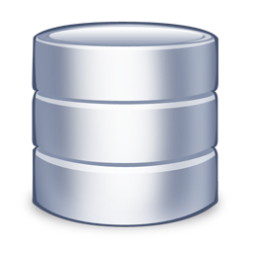
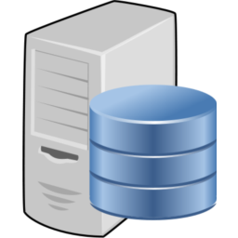

Source Repository
Build Server
Development Machine

